Slide 1


2nd General Meeting
CUERT

Slide 2

CAIRO UNIVERSITY ECO-RACING TEAM
Our Competitions
Agenda
1
team time
2
coming actions
3
MORE MILES TO ACHIEVE
WWW.CU-ECO.ORG

Slide 3


Competitions
CAIRO UNIVERSITY ECO-RACING TEAM
Shell Eco-marthon
On-track award
urban concept competition
prototype concept competition
autonomous urban competition
virtual autonomous competition
Phase 1
MORE MILES TO ACHIEVE
WWW.CU-ECO.ORG

Slide 4
Competitions
CAIRO UNIVERSITY ECO-RACING TEAM
Shell Eco-marthon
Off-track award
communication award
Data and Telemetry
Carbon Footprint Reduction
Technical Innovation sponsored
Safety Leadership
Spirit of Shell Eco-marathon
MORE MILES TO ACHIEVE
WWW.CU-ECO.ORG

Slide 5

Competitions
CAIRO UNIVERSITY ECO-RACING TEAM
b. EVER Egypt
concept competition
autonmous competition
MORE MILES TO ACHIEVE
WWW.CU-ECO.ORG

Slide 6
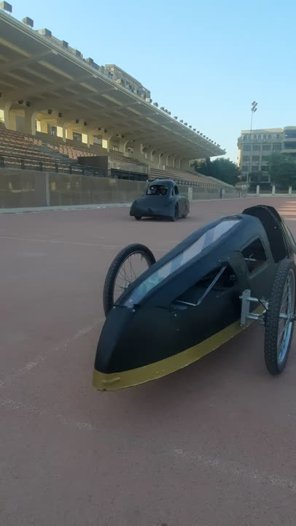
TESTS
CAIRO UNIVERSITY ECO-RACING TEAM
MORE MILES TO ACHIEVE
WWW.CU-ECO.ORG

Slide 7
TEAM TIME
CAIRO UNIVERSITY ECO-RACING TEAM
Autonomous subteam
Autonomous development
Autonomous embedded
MORE MILES TO ACHIEVE
WWW.CU-ECO.ORG

Slide 8
TEAM TIME
CAIRO UNIVERSITY ECO-RACING TEAM
Electrical subteam
Power electronics
Electrical Control
MORE MILES TO ACHIEVE
WWW.CU-ECO.ORG

Slide 9
TEAM TIME
CAIRO UNIVERSITY ECO-RACING TEAM
Mechanical subteam
Engine
Power transmission
Body and chassis
Vehicle dynamics
MORE MILES TO ACHIEVE
WWW.CU-ECO.ORG

Slide 10
TEAM TIME
CAIRO UNIVERSITY ECO-RACING TEAM
Communication sector
Public relation and fundraising
Logistics and planning
People development
Media
MORE MILES TO ACHIEVE
WWW.CU-ECO.ORG

Slide 11

CAIRO UNIVERSITY ECO-RACING TEAM
57% passed
MORE MILES TO ACHIEVE
WWW.CU-ECO.ORG

Slide 12

Thank You Slide
MORE MILES TO ACHIEVE
WWW.CU-ECO.ORG

